Slide 1
Table of Contents
Stylus Overview
Expressive, dynamic, robust CSS
Preprocessors Overview
Preprocessors for CSS (Stylus, Sass/SCSS, LESS)
Stylus basics
Stylus syntax
Selectors and selector nesting
Setup and usage
Installing Node.js
Installing Stylus package
Using Stylus in Editors

Slide 2
Table of Contents
Stylus features:
Variables
Interpolation
Property lookups
Creating and using mixins
Functions
Using built-in functions
Creating functions
Linking other stylus files

Slide 3
Preprocessors Overview
What is a Preprocessor?
A preprocessor is a program that processes its input data to produce output that is used as input to another program
Sass, Less, Stylus are preprocessors for CSS
CoffeeScript, TypeScript are preprocessors for JavaScript
Jade, Ejs are preprocessors for HTML

Slide 4
Introduction to Stylus
Selectors and stuff

Slide 5
What is Stylus?
Stylus is a preprocessor for CSS
All Stylus code is compiled to pure CSS
Extends CSS, without breaking it
Adds a lot of syntactic sugar
Adds a "dynamic" functionality
Removes "not-necessary" code

Slide 6
Stylus Syntax
The Stylus syntax is clean and easy
Removes all not-necessary symbols
Semicolons, curly brackets, etc…
Significant whitespace is what matters
Indentation marks the scope
CSS
#root
display block
width 960px
margin 0 auto
border 1px solid black
#root{
display: block;
width: 960px;
margin: 0 auto;
border: 1px solid black;
}
Stylus

Slide 7
Stylus Syntax
#root{
display: block;
width: 960px;
margin: 0 auto;
border: 1px solid black;
}
CSS
Remove:
The curly brackets
The semicolons
The colons
Becomes
#root
display block
width 960px
margin 0 auto
border 1px solid black
Stylus
Stylus extracts only the things that matter!

Slide 8
Selectors and Selector Nesting in Stylus

Slide 9
Selectors in Stylus
Stylus selectors are absolutely the same as in regular CSS
Every CSS code is valid Stylus code!
.class, #id, tagName
Yet, Stylus supports nesting of selectors:
.hlist {
list-style-type: none;
}
.hlist .list-item {
float: left;
border-right: 1px solid #ccc;
}
.hlist .list-item:last-of-type {
border-right: none;
}
.hlist
list-style-type none
.list-item
float left
border-right 1px solid #ccc
&:last-of-type
border-right none
CSS
Stylus
Selectors and Selector Nesting in Stylus – Live Demo

Slide 10
Stylus: Setup and Usage
Installing the tools

Slide 11
Stylus: Setup and Usage
To use Stylus:
Install Node.js
Install Stylus package for Node.js
Install a plugin for your editor

Slide 12
Installing Node.js
Visit the Node.js website: https://nodejs.org/
Install it
Make sure Node.js is added to PATH
Node.js is installed on the machine and can be used through the CMD/Terminal

Slide 13
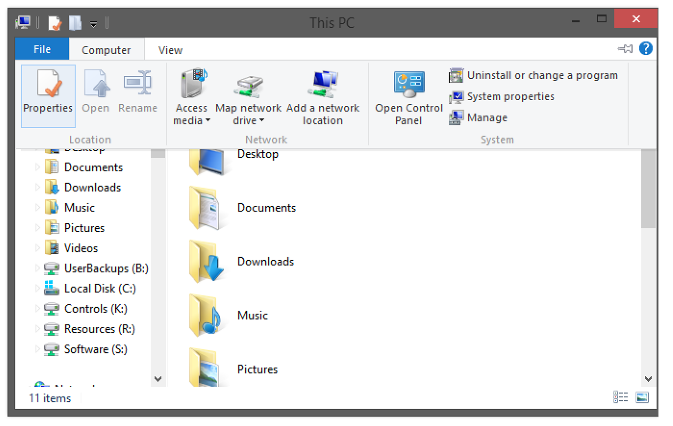
Adding Node.js to Path on Windows (1)
Go to "Computer" -> "Properties"

Slide 14
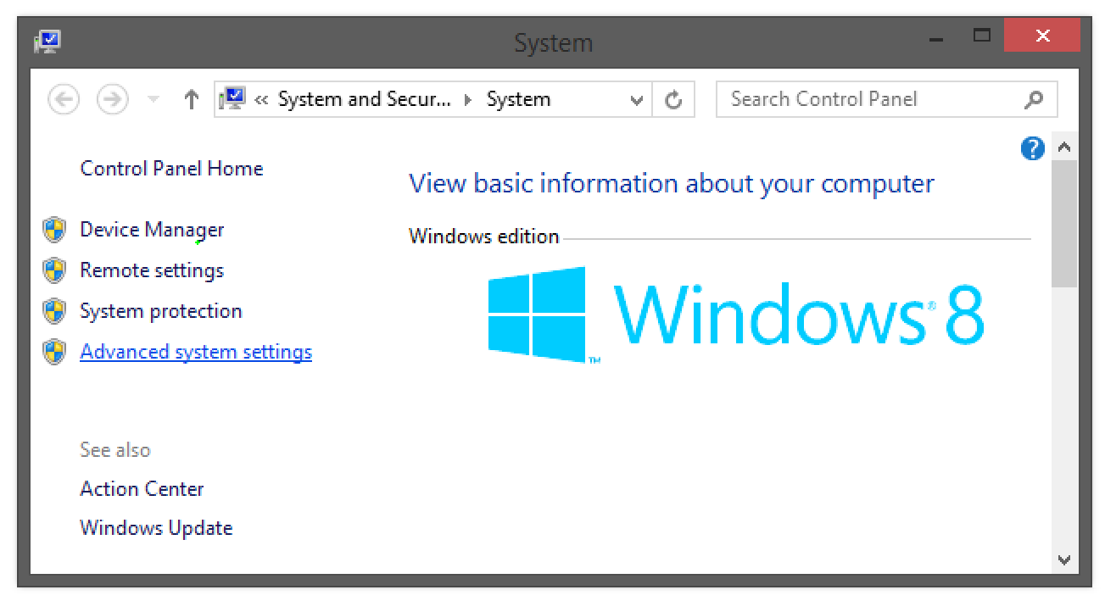
Adding Node.js to Path on Windows (2)
Go to "Advanced system settings"

Slide 15
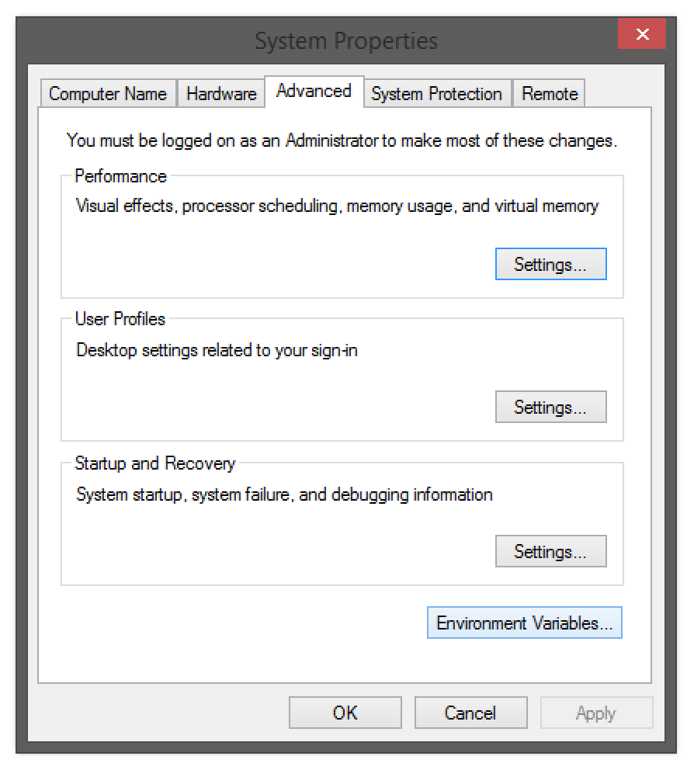
Adding Node.js to Path on Windows (3)
Go to "Advanced" -> "Environment Variables"

Slide 16
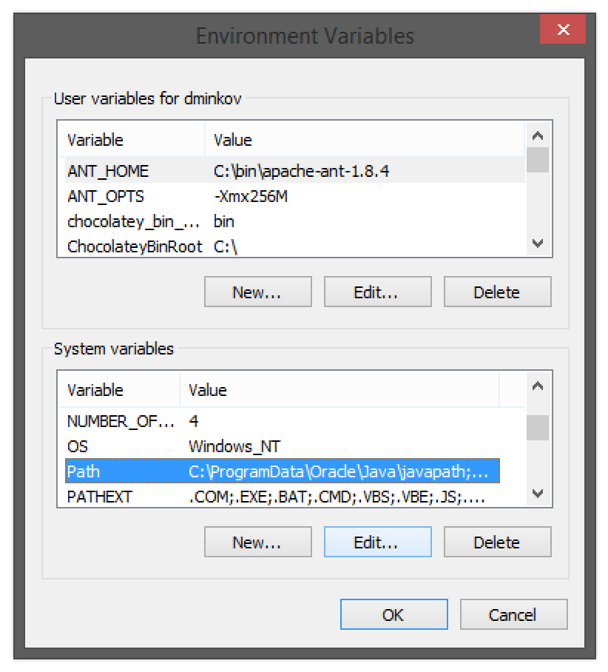
Adding Node.js to Path on Windows (4)
Go to "System Variables" -> "Path" -> "Edit"

Slide 17
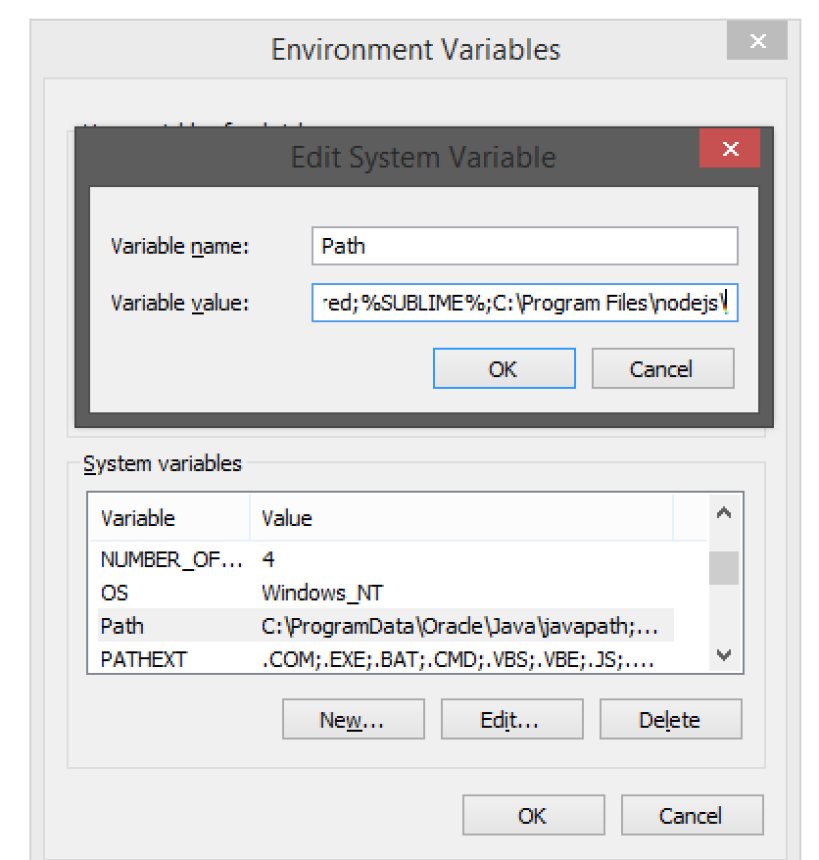
Adding Node.js to Path on Windows (5)
Add to the end:
;C:\Program Files\nodejs\
Adding Node.js To Path on Windows – Live Demo

Slide 18
Adding Node.js to Path on Linux and OS X
Open ~/.bashrc with admin sudo
Find the Node.js path
Usually it is "/usr/bin/node"
Add the Node.js path to ~/.bashrc
You have Node.js in the PATH
PATH=/usr/bin/node:$PATH
Adding Node.js to Path on OS X – Live Demo

Slide 19
Installing Stylus
Install Node.js
Make sure Node.js is in PATH
Open CMD/Terminal
Run
Stylus is installed on the machine
$ npm install stylus -g
Installing Stylus – Live Demo

Slide 20
Using Stylus
Stylus code must be compiled to CSS
There are a few ways to achieve that:
Using the Node.js Terminal/CMD
$ stylus main.styl
$ stylus main.styl --watch
Or use plugins for your favorite editor:
Sublime Text 2/3
Atom.io
Visual Studio
Brackets
WebStorm
Using Stylus With Node.js – Live Demo
Using Stylus with Editors – Live Demo

Slide 21
Stylus Features
Variables, Functions, Mixins, Variables, etc…
Stylus supports:
Variables
Interpolation
Property look-up
Functions and mixins
Selector inheritance
Conditionals and Iteration
Many more

Slide 22
Stylus Features: Variables
Creating and using Variables

Slide 23
Stylus Features: Variables
Variables in Stylus are defined easy:
As a regular property/value pair, but using "=" (equals sign) instead of ":" (colons)
Can be used to store colors, size, etc…
Usable to set default background-color, font-color, font-size, etc…
link-color= #ffffff;
v-link-color= #646363;
a
color link-color
&:visited
color @v-link-color
a {
color: #fff;
}
a:visited {
color: ;
}
Stylus
CSS
Stylus Features: Variables – Live Demo

Slide 24
Stylus Features: Interpolation
Interpolation means inserting variable value as a property/selector name
Interpolation is performed sing {…}
side= 'top'
number= 5
.box-{number}
border-{side} 1px solid black
Stylus
.box-5 {
border-top: 1px solid #000;
}
CSS
Stylus Features: Interpolation – Live Demo

Slide 25
Stylus Features: Property Look-up
Getting the values of other properties

Slide 26
Stylus Features: Property Look-up
Stylus supports property look-up
i.e. check the values of a property
Stylus
.box
width 100px
height (@width/2)
border-radius max(@width, @height)
CSS
.box {
width: 100px;
height: 50px;
border-radius: 100px;
}
Stylus Features: Property Look-up – Live Demo

Slide 27
Stylus Features: Built-in Functions
Stylus has a set of predefined functions for:
Working with colors:
color= /* some color */
dark(color) /* returns "true", if "color" is dark
light(color) /* returns "true" if "color" is light
color: darken(#123456, 10%) /* returns #102f4d */
color: lighten(#123456, 15%) /* returns #1d5288 */
Working with lists:
props = (padding 5px) (display block)
push(props, (float left))
Find all built-in functions in Stylus at https://learnboost.github.io/stylus/docs/bifs.html
Stylus Features: Built-in Functions – Live Demo

Slide 28
Stylus Features: Functions
Stylus supports definition of developer functions:
sum(items)
sum = 0px
for val in items
sum = sum + val
sum /* return sum */
Used as a regular function
font-size: sum(14px 28px 45px)
height: sum(@width + 150px)
Stylus Features: Functions – Live Demo

Slide 29
Stylus Features: Mixins
Both mixins and functions are defined in the same manner
Yet they are applied in different ways
Functions return a value, mixins generate CSS
vendor(prop, args)
-webkit-{prop} args
-moz-{prop} args
{prop} args
.button
vendor('opacity', 0.5)
vendor('border-radius', 15px)
Stylus
.button {
-webkit-opacity: 0.5;
-moz-opacity: 0.5;
opacity: 0.5;
-webkit-border-radius: 15px;
-moz-border-radius: 15px;
border-radius: 15px;
}
CSS

Slide 30
Mixins (2)
How to define mixins?
Use mixin-name
Then the styles are normal Stylus
How to use the mixin?
Place use mixin-name or mixin-name()
clearfix
zoom 1
&:after
/* code for clearfix */
ul#main-nav{
clearfix()
}
Stylus Features: Mixins – Live Demo

Slide 31
Stylus Features: Mixins with Arguments
Mixins can also be defined with parameters
i.e. for gradient-background
Use the arguments like a C#/JS/C++ methods
box(border= none, bg= rgba(0, 0, 0, 0.7), size= 200px)
width size
height size
border border
background bg
border-radius 15px
.rect
display inline-block
box '1px solid black' rgba(123, 0, 0, 0.6) 100px
Stylus Features: Mixins with Arguments – Live Demo

Slide 32
Stylus Features: Selector Inheritance
Reusing Stylus Code

Slide 33
Selector Inheritance
Selectors in Stylus can be inherited using @extend
Meaning add a selector to a previously defined selectors list:
.clearfix
zoom 1
&:after
/* code for clearfix */
.list-item
float left
padding 5px 15px
&:last-of-type
border-right: none
@extend .clearfix
CSS
Stylus
.clearfix,
.list-item:last-of-type {
zoom: 1;
}
.clearfix:after,
.list-item:last-of-type:after {
/* code for clearfix */
}
.list-item { /* … */ }
.list-item:last-of-type { /* … */ }
Stylus Features: Selector Inheritance – Live Demo

Slide 34
@exntend or Mixins?
Why both mixins and @extend?
Mixins have parameters and generate different code, based on the parameters
@extend provides a way to minify the number of classes on an element
Instead of adding .clearfix to all elements that clear, add it to the selector that the elements already have
@extend or mixins? – Live Demo

Slide 35
Stylus Scripting
Conditionals and Iteration
Stylus supports elementary scripting
Something like JavaScript, but not quite
Conditionals:
Iteration:
body
if theme is 'dark'
background #333
color #ccc
else if theme is 'light'
background #ccc
color #333
else
error('unknown theme!')
for i in (1...15)
.item-{i}
if i%2
c= yellowgreen
bc= #ccc
else
c= lightblue
bc= #333
color c
background-color bc
Stylus Scripting – Live Demo

Slide 36
Creating Libraries and Importing Stylus files
Like CSS, Stylus has a @import directive
The CSS loads another CSS file
In CSS, @import loads a CSS file with an additional HTTP request
In Stylus, @import just loads the code from the file inside our file
.clearfix
/* … */
linear-gradient(stops)
/* … */
@import 'utils.styl'
body
linear-gradient #333 #fff
utils.styl
Creating Libraries and Importing Stylus files – Live Demo

